Slide 1



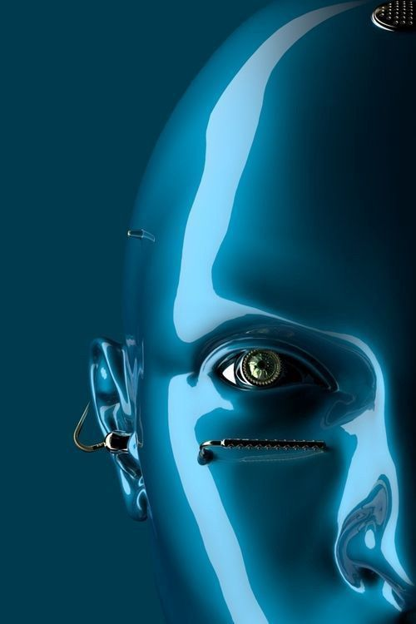
Mini Project
Extract And Organize
Information In Images With AI Using IBM Services

Slide 2

Mini Project
Team
Extract And Organize Information
In Images With AI Using IBM Services
18UK1A05A6 CHEEKATI SAIRACHANA
18UK1A05E4 KATKOJU SANKEERTHI
18UK1A05A2 RAMARAPU YAMINI
18UK1A05C7 CHILPURI SHIVATEJA
Team 8
Mentor - B. Prashanthi
(IV Year)

Slide 3
Abstract
Humans are bound to make errors-some time or the other – especially while performing mundane boring tasks like digitization or security ,Continuously. Many times we are unable to perceive certain digits due to various factors-motion, lack digit clarity, illumination and so on. It is these problems which have lead us to delve into this topic
We as a team going to tackle With the advent of OCR techniques, much time has been saved by automatically extracting the text out of a digital image of any invoice or a document. Currently, this is where most organizations that use OCR for any form of automation are Digital copies of invoices or documents are obtained by scanning or taking pictures. The text is extracted from these documents is entered into a template-based data entry software.
The project aims at creating an application form where the user can upload a pdf document/Image containing text, the document is analysed by an Optical character recognition (OCR) to extract text from it. The extracted text is again saved in a text document in the local drive.

Slide 4
Introduction
Literally, OCR stands for Optical Character Recognition. It is a widespread technology to recognize text inside images, such as scanned documents and photos. OCR technology is used to convert virtually any kind of image containing written text (typed, handwritten, or printed) into machine-readable text data.
OCR Technology became popular in the early 1990s while attempting to digitize historic newspapers. Since then the technology has undergone several improvements. Nowadays solutions deliver near to perfect OCR accuracy. Advanced methods like Zonal OCR are used to automate complex document-based workflows.
OCR is often used as a “hidden” technology, powering many well-known systems and services in our daily life. Less known, but as important, use cases for OCR technology include data entry automation, indexing documents for search engines, automatic number plate recognition, as well as assisting blind and visually impaired persons.

Slide 5
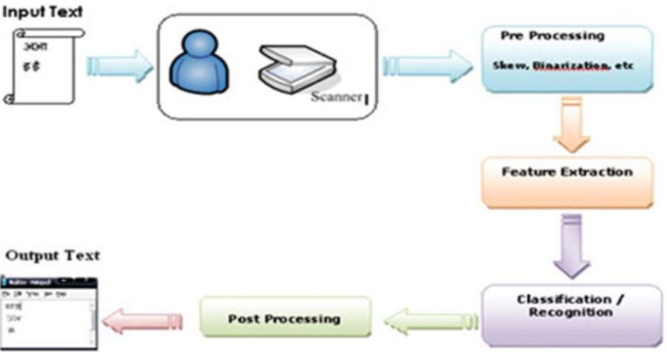
Overview

Slide 6
Project Workflow
Upload a pdf document
Convert PDF document to image
Extract the text from the image
Store the extracted text in the text document

Slide 7
Technologies
Python IDE
Python Packages
Opencv
Pdf2image
Pytesseract
Tessract-Ocr
Install Poppler
HTML / CSS (with bootstrap)
IBM Cloud

Slide 8
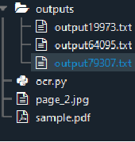
Text Extraction In Documents
The "outputs" subfolder contains the text documents of processed pdf documents.
"sample.pdf" is a sample pdf file from which text is been extracted.
"ocr.py" file has the code which implements text extraction.
"sample.pdf" will be converted into an image and is saved as a jpg image in the folder.

Slide 9
Text Extraction Code
Implement text extraction code in OCR.py Python file This includes the following steps
Step 1: Loading necessary libraries
Step2: Load necessary initializations
Step3: Save the images of PDF in the folder
Step4: Recognizing the text from OCR

Slide 10
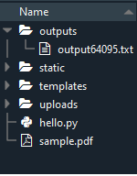
Build Flask Application
Flask Structure
Create a project folder which should contain
A python file called hello.py
Necessary folders for CSS and bootstrap
Templates folder which contains the index.HTML file
Hello.py python file implements Text extraction.
uploads folder will contain the pdf folder when you upload any file from the UI.

Slide 11
Build HTML Code
The basic HTML page for our Project. Here we are creating two buttons one used to browse PDF documents from the local drive and another button is used to send this pdf for text analyses.
Build Python Code
We will be using python for server-side scripting. Let’s see step by step process for writing backend code.
Importing Libraries
Importing flask module in the project is mandatory. An object of Flask class is our WSGI application. Flask constructor takes the name of the current module (__name__) as an argument
Load the necessary initializations and files needed for People Counter and Tracking
Implement a route and a function, which accepts pdf from the web page, stores it in the folder and then apply text extraction analysis

Slide 12
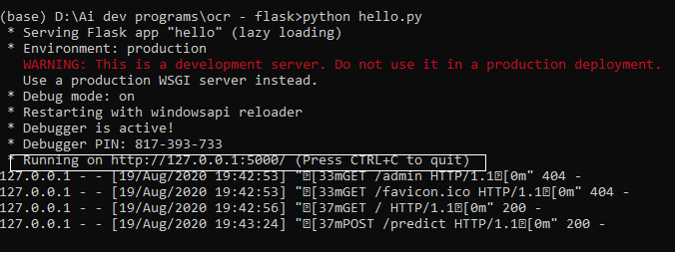
Run The App
Open anaconda prompt/command from the start menu
Navigate to the folder where your app.py resides
Now type “python hello.py” command
It will show the local host where your app is running.
Navigate to the localhost where you can view your web page.

Slide 13
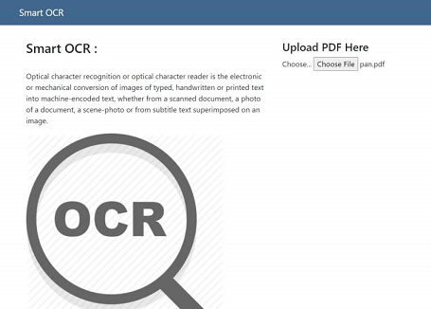
When a pdf is uploaded the resultant text file will be stored in local drive with extension as .txt

Slide 14
Deploy Application On IBM
In this milestone, we will be deploying our flask app in IBM Cloud as a cloud foundry application.
Register For IBM Cloud
Deploy On IBM
We will be creating a python flask app in IBM cloud and we will be using Cloud Foundry CLI to deploy in IBM Cloud.

Slide 15
Conclusion
OCR Technology provides fast,automated data capture which can save considerable time and labour costs of organisations.
The system has its advantages such as Automation of mudane tasks,Less time Complexity,Very small Database and High Adaptability to untrained inputs with only a small number of features to calculate

Slide 16
Thank You

